Slide 1
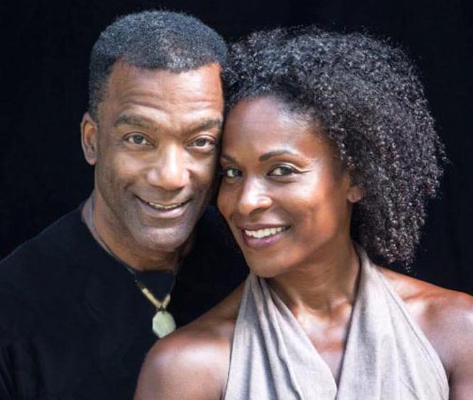
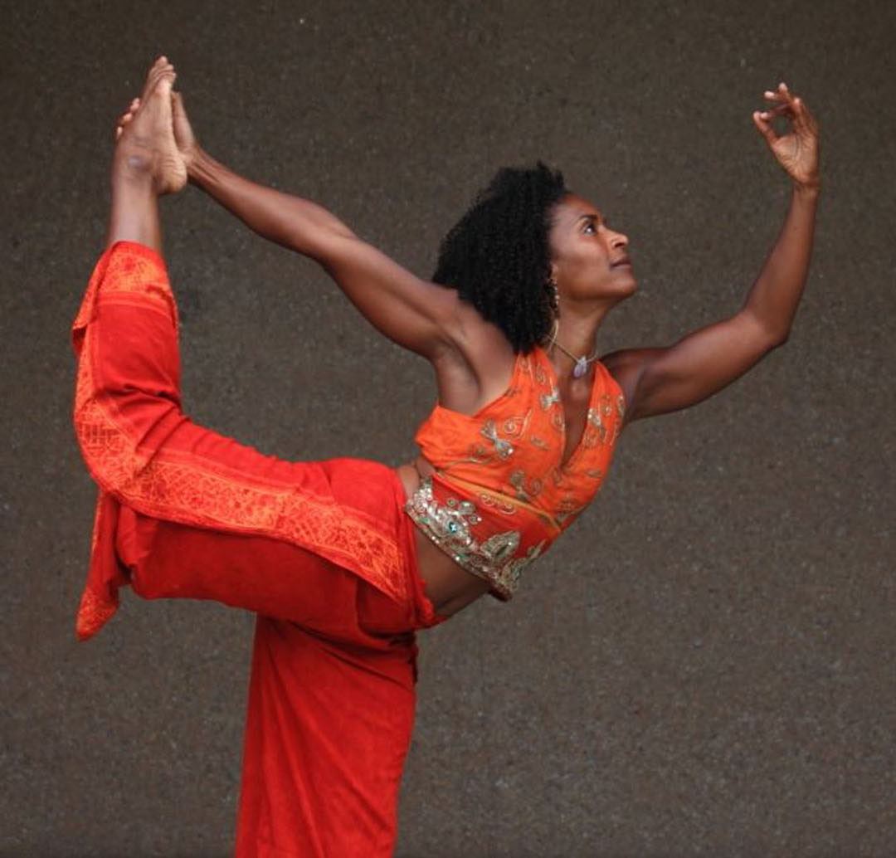
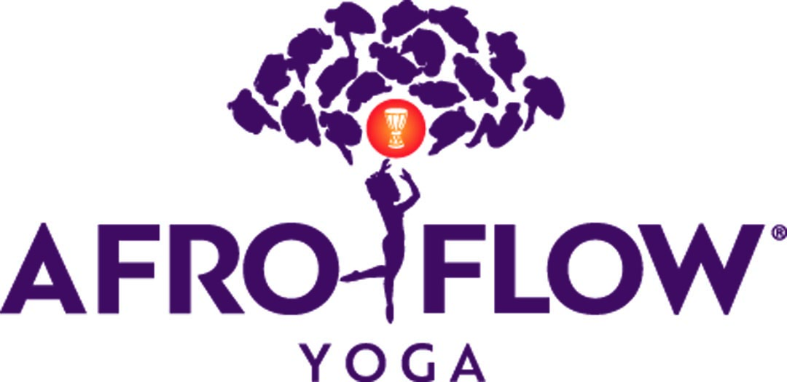
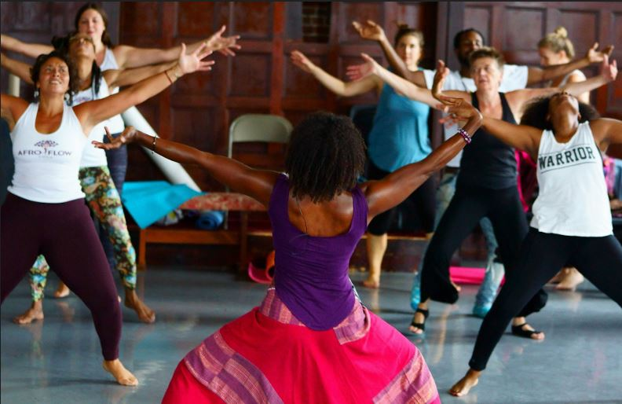
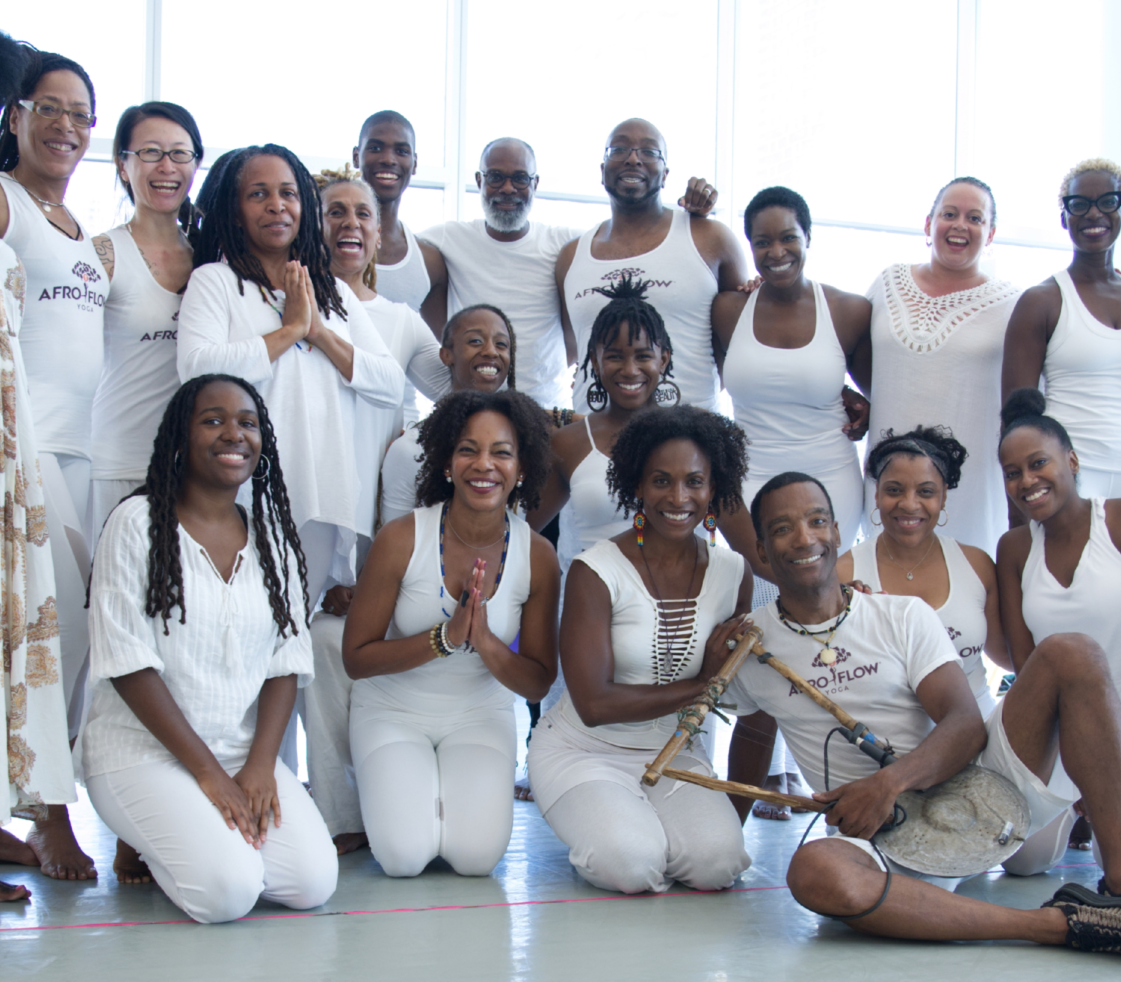
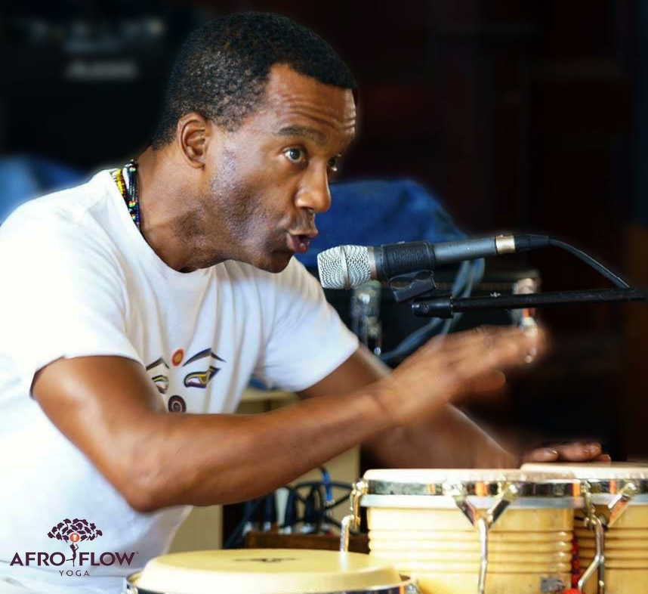
AFRO FLOW YOGA®
PRESS KIT

Slide 2
WHAT IS
AFRO FLOW YOGA®?
Afro Flow Yoga® is an embodied practice integrating dance movements of the African diaspora with meditative yoga and live healing music, promoting individual and collective healing in a compassionate, non-judgmental, inclusive, and safe environment. Afro Flow Yoga® is a unique approach to physical, emotional, and mental wellness.
As a company, we offer in-person and virtual classes, workshops, retreats, discussions, and teacher training programs, building community, and cultivating activism through the lens of the African diaspora, offering educational resources on the history of racism, deconstructing racism, and healing our roots.
Afro Flow Yoga® has been featured in Yoga Journal, Black Enterprise, Essence, and Oprah Magazines, “Better Living with Liz Walker,” NPR, NBC and ABC news and was voted “Boston’s Best” yoga class in 2016 by the Improper Bostonian. Afro Flow Yoga® has been featured in a 2019 documentary on Oprah Winfrey's OWN network, "Dark Girls 2.
Our co-founders and certified instructors have delivered workshops and retreats domestically and internationally, including to the Kripalu Center, the Omega Institute, Brigham and Women’s Hospital, Massachusetts General Hospital, the Mind Body program at the Cory Johnson Trauma Education Program in Roxbury MA; the Indige-Spheres to Empowerment programs in Northern Ontario, Canada, dedicated to the health and well-being of Indigenous peoples; and the annual Omega Women’s Leadership Intensive and at The Omega Women’s Leadership Center.
We have expanded our circle from the heart of Boston, MA to Arizona, Colorado, California, New York, Pennsylvania, Washington D.C., Hawaii, and we continue to grow. Our global reach includes Canada, Jamaica, Costa Rica, Bali, and Tel Aviv.
OUR
MISSION
To make healing and transformation accessible to all individuals, communities and the world. By connecting to our roots, we inspire unity, love, harmony and interconnection to all beings and the earth while striving for social justice and equity.
We envision a world where nature has been restored back to a state of harmony. Through the traditions and teachings of dances of the African Diaspora, yogic practices, healing rhythms, love, and compassion, we celebrate our interconnection and honor and respect our shared humanity and cultural differences through the deep wisdom of our personal stories and stories and traditions of our ancestors, bridging cultural divides through ritual, healing, joy, nature and the recognition of our Oneness in the Divine.
VISION
WHO WE
REACH
People of all backgrounds ranging in age, size, color, shape, faith, generation, gender, and socio-economic backgrounds who are interested in improving the well-being of themselves and others. While Afro Flow Yoga® collaborates with all people, we have a deep commitment to the heritage, empowerment, education, healing, spirituality, and wellness of Black, Indigenous and communities of color..

Slide 3
MEANING OF OUR LOGO
The Afro Flow Yoga® logo has within it several symbols representing our mission and vision. First, the tree which represents connecting to our roots and the energy of nature. The leaves of the tree are people in fetal position which represents new beginnings and the raising of consciousness. Then we have a woman in the middle, who is the dancer in all of us. The center of the logo is the drum which represents rhythm, like a heartbeat and has been used to call the spirits of our ancestors.

Slide 4
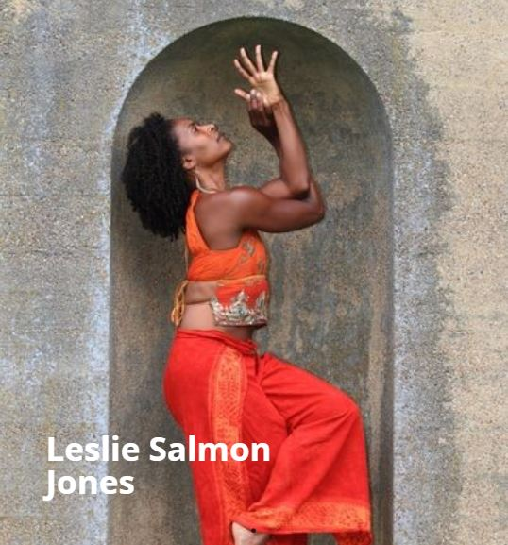
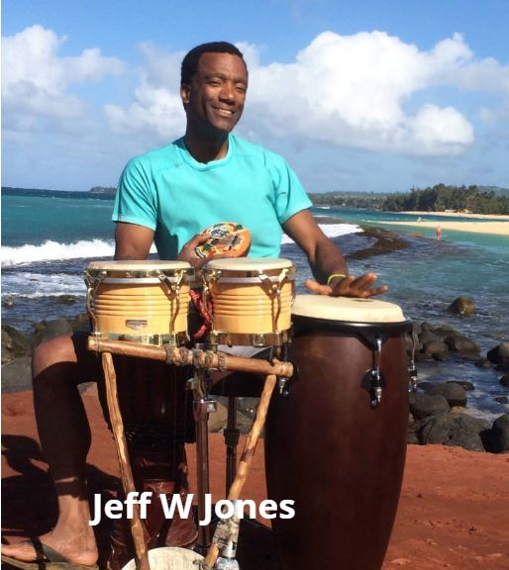
OUR FOUNDERS
BOSTON
LESLIE SALMON JONES and her husband Jeff W. Jones are co-founders of Afro Flow Yoga®. Together they have developed an integrated embodied practice, combining dances from the African Diaspora, yoga, and live healing music promoting individual and collective healing in a compassionate, non-judgmental, inclusive, and safe environment.
Leslie is an Alvin Ailey trained dancer, yoga practitioner, teacher, and wellness coach. She speaks, coaches, and teaches internationally and in addition, is a co-creator and faculty member for the annual Omega Women’s Leadership Intensive.
JEFF W. JONES is a professional engineer, multi-instrumentalist, vocalist, composer, and musical director who has traveled the world with musical greats including Little Richard, Al Green, and Zap Mama, to name just a few. He has also performed for the inaugurations of President Barack Obama and Governor Deval Patrick. Through music, Jeff creates an intuitive flow with mastery and his inspired use of an eclectic array of tonal instruments ground and center the yoga practice.
Leslie and Jeff have also co-facilitated the Mind Body program at the Cory Johnson Trauma Education Program, offering a safe space for people to share their stories of trauma, healing, hope and recovery. They are passionate about intergenerational, multi-cultural empowerment, education, healing, spirituality, and the wellness of all whom they serve.

Slide 5
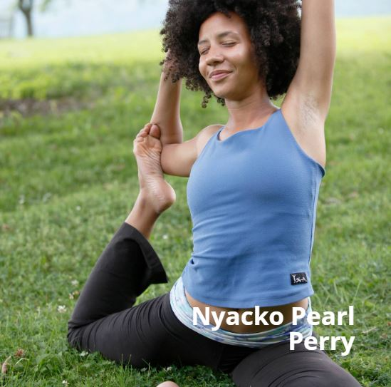
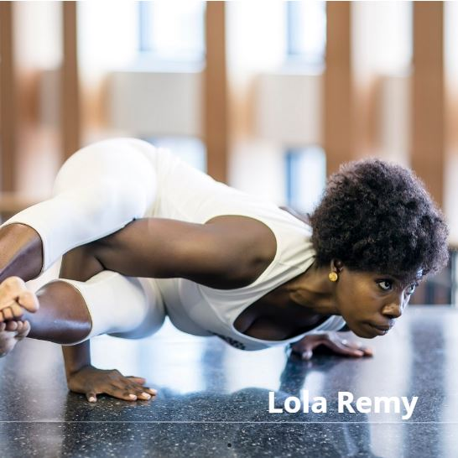
MEET OUR TEAM
NYACKO PEARL PERRY is an Afro Flow Yoga® Certified Teacher, Nyacko is a 500 Hour Professional Level Yoga Teacher and a Returned Peace Corps Botswana Volunteer.
She is also the founder of Yin Consulting, an organization development and wellness group whose vision is to create a more racially just and inclusive world for all. Her expertise includes program management, public health and youth empowerment.
Nyacko holds a Masters with Distinction in Organization Development from American University and is a recipient of the university’s Segal-Seashore Fellowship Award for her commitment to social justice. When Nyacko is not flowing, she can be found in nature with her partner Biplaw and their two Olde English Bulldogs. www.yinconsulting.com
BOSTON
Originally from Port-au-Prince, Haiti, LOLA REMY has been a student and mentee of Leslie Salmon Jones since 2015. She is grateful for every opportunity to share and lead the flow.
She has studied and performed the dances of Africa and the African diaspora for over 15 years. She uses dance and movement as a mode of self-exploration and expression and she encourages others to do the same. Lola teaches dance, therapeutic yoga and movement, and fitness classes in Cambridge and Boston. She has performed and created choreography for theater and dance ensembles including Praxis Stage, Benkadi Dance and Drum, Beat Tree, Cape Cod African Dance and Drum and, Pasy Naay Leer Dance Company.
BOSTON

Slide 6
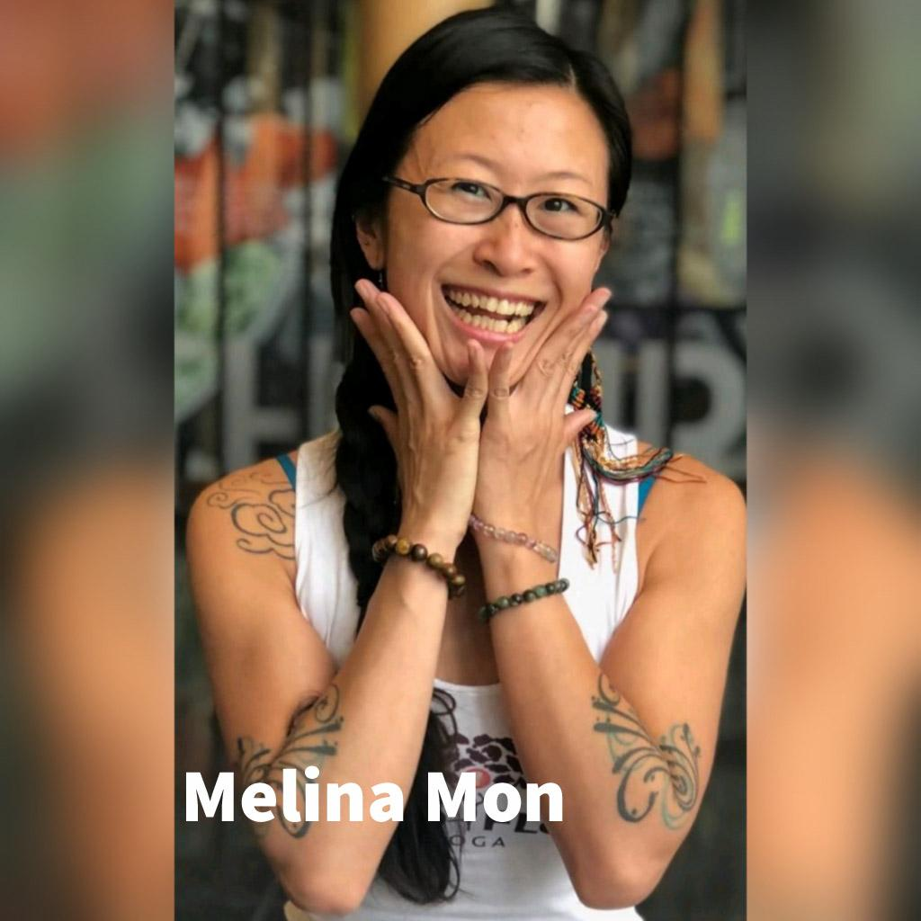
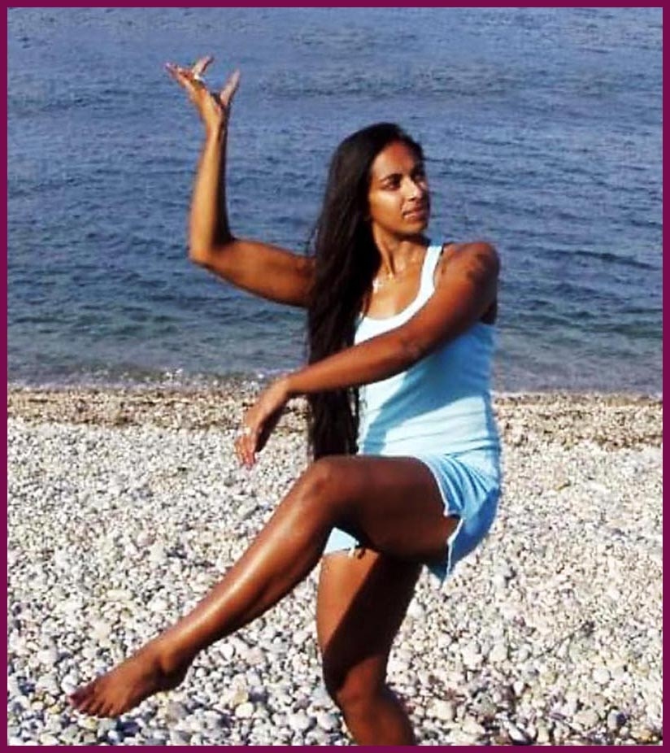
MEET OUR TEAM
MELINA MON was first introduced to Afro Flow Yoga® in 2013 through Spirit and ceremony and quickly committed to becoming a part of the AFY community. She is an avid practitioner of Afro Flow Yoga® and is currently training to become an instructor as well.
She is a healing facilitator who has been in the Health and Wellness field professionally since 2010. She is certified as an Orthopedic Massage Therapist, an Advanced Reiki Provider, a Traditional Chinese Medicine (TCM) Herbalist, and happens to be an Ordained Minister. Melina has learned from elders and medicine people in oral traditions, ritual and ceremony of First Nations people across points of North America. Her life’s work has taken on a blending of many cultural medicines, and she channels this energy into her practice of Afro Flow Yoga® as well.
BOSTON
GAYA ARUMUGHAM found Afro Flow Yoga® after completing a 200 HR YTT when seeking a practice more authentically connected to the traditional roots of yoga. She found the AFY circle to be nourishing, supportive, and inspiring. She is currently training to become an Afro Flow Yoga® instructor as well.
She has 20 years experience as a Grant Writer and a Bharatha Natyam teacher/performer. Gaya is a first-generation immigrant, with her roots in Tamil Nadu, South India. She was born and raised in the US and has spent a significant amount of time in India, traveling, connecting with family, and studying dance with eminent gurus.
Gaya started doing yoga from a young age as she is a direct descendant of Swami Satchidananda, the founder of Integral Yoga. She graduated from University of Michigan with honors in sociology and criminology and went on to obtain an MPA in Non-Profit Management from NYU
BOSTON

Slide 7
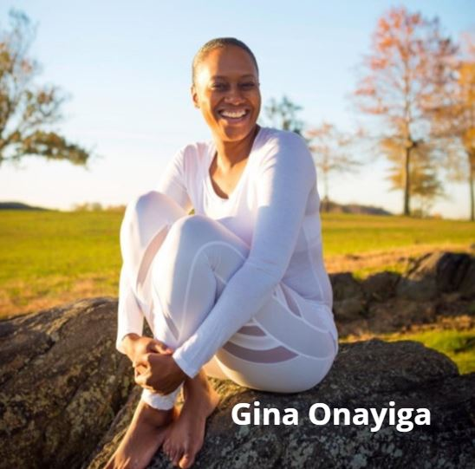
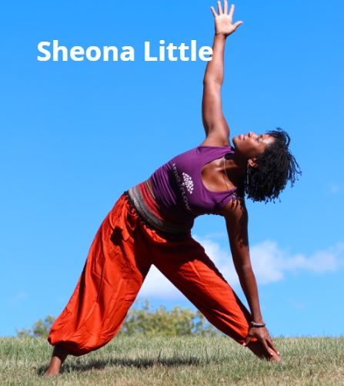
MEET OUR TEAM
GINA ONAYIGA, LCSW is an Afro Flow Yoga® certified teacher and took Afro Flow Yoga® classes, then enrolled in Teacher Training. Following her commitment to yoga and rhythm, Gina recognized the benefits of yoga immediately after being introduced to it in 2010 as a means of coping with a demanding foster care job.
She is a daughter of Haitian-born parents who filled her ears with music of the diaspora from birth, so she developed an early appreciation for rhythm and body movement by connecting to her roots.
Gina obtained both a Bachelor’s and a Master’s degree in Social Work from Mercy College and Fordham University, respectively. With experience ranging from child welfare, behavioral health, transitional housing, and early education, Gina is committed to serving communities that do not have easy access to yoga.
NEW YORK
SHEONA LITTLE a certified Afro Flow Yoga Instructor and a 200hr LYT. She was introduced to Afro Flow Yoga® through a friend of hers who encouraged her to do the training. As soon as she connected with Leslie Salmon Jones and learned more about the Afro Flow Yoga® program, she was immediately hooked!
Sheona has a Master’s degree in education with over 15 years of experience in urban education, mentoring, the arts, and youth advocate programing. She is a native of Harrisburg, Pennsylvania and began her love of dance and community service as a child, while performing with the Harrisburg Dance Conservatory where she knew she wanted to uplift and inspire people, especially people of color.
Sheona is committed to serving and educating the underserved and disadvantaged communities to promote healing, wellness, and education. She is the founder of Siyanda Esha Wellness, a collaboration of health and wellness experts to help people through quality holistic health and wellness programs. www.siyandawellness.com
PHILADELPHIA

Slide 8
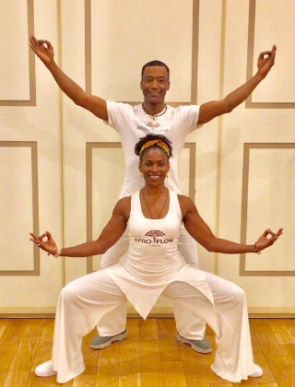
SERVICES
THEMES
TEAM BUILDING
EQUITY, DIVERSITY & INCLUSION
ANTI-RACISM
YOUTH PROGRAMS
COMMUNITY BUILDING
STRESS MANAGEMENT
HEALTH AND WELLNESS
BLACK HISTORY
LEADERSHIP
SOCIAL ACTIVISM
WHAT WE DO
WHO WE WORK WITH
VIRTUAL AND IN-PERSON CLASSES & WORKSHOPS
RETREATS
SPECIAL EVENTS
TEACHER TRAINING
SPEAKING ENGAGEMENTS
CONFERENCES
PUBLIC
PRIVATE
CORPORATE
SCHOOLS & UNIVERSITIES
NON-PROFIT
FAMILIES
YOUTH
SPECIAL POPULATIONS
HEALTH PROFESSIONALS
LENGTH OF CLASSES
60 MINS
90 MINS
CUSTOMIZED UPON REQUEST
FOR BOOKINGS
CLICK HERE

Slide 9
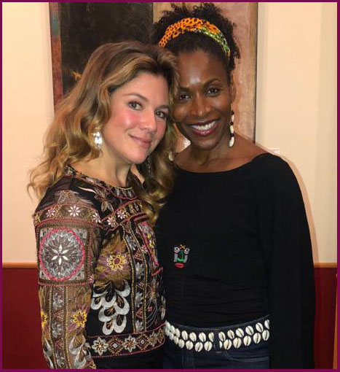
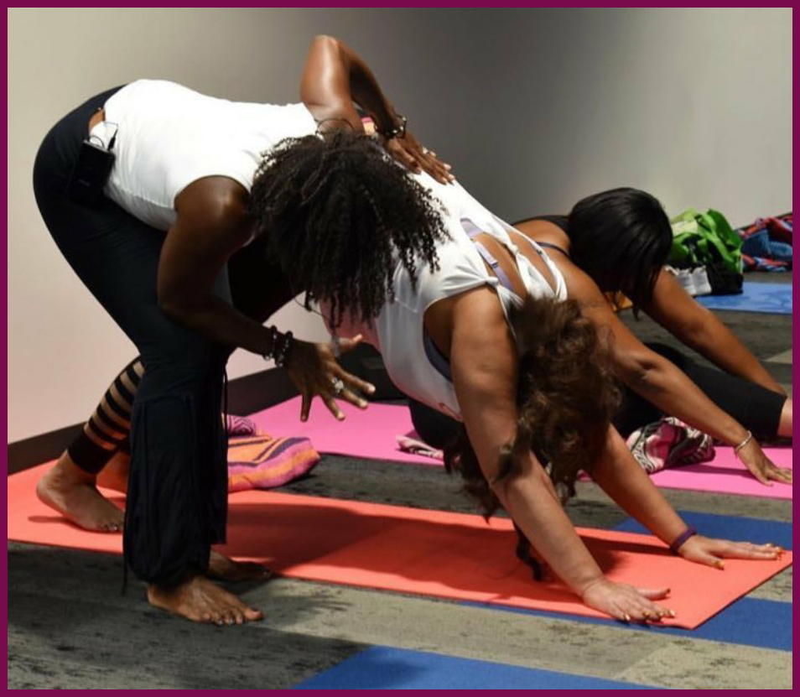
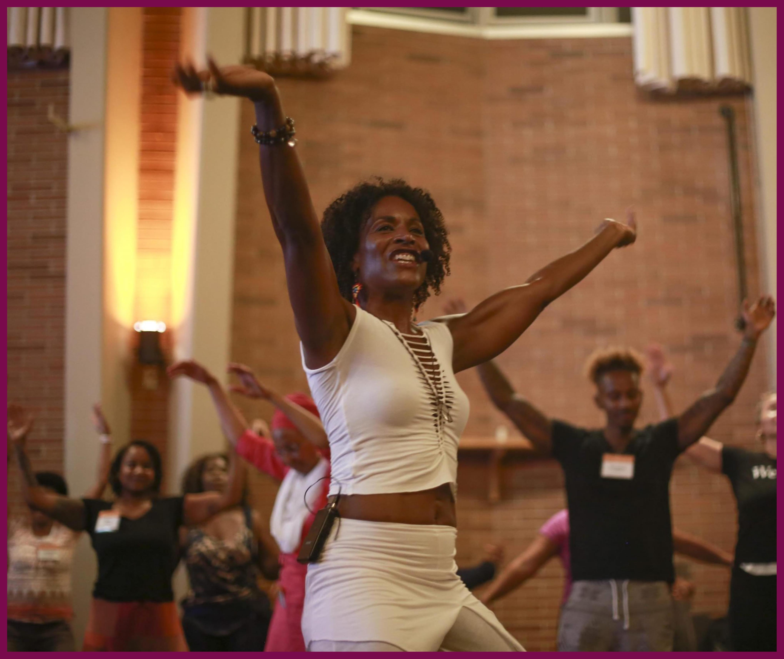
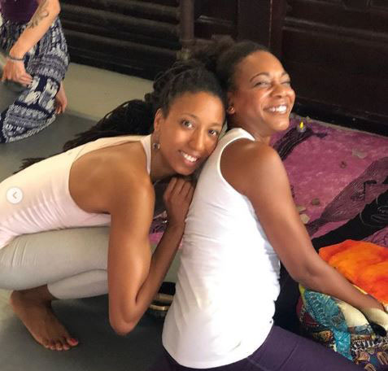
TESTIMONIALS
“There are so many different voices in yoga, and I present to you inspiring and transformative teachers with whom I have practiced. Canadian activist Leslie Salmon Jones, co-founder of @ AfroFlowYoga, along with Jeff W. Jones (co-founder, musician and husband) promote yoga, dance and music using a variety of instruments including drums. Their classes are filled with depth, joy, love and dance!”
~ Sophie Grégoire Trudeau, wife of Prime Minister Justin Trudeau and women and children’s activist
“Being our longest running signature community programs, Afro Flow Yoga has helped to us shape and define our space as a place of restoration, healing and community-bridging one flow at a time.” ~ Marisa Luse, Campus Engagement and Collaborations Manager, Northeastern Crossing
“I would highly recommend Afro Flow Yoga for any team-building events your organization might have. Whether for a small group or a large party, they’re fantastic. Afro Flow Yoga has performed at our company parties more than once - they are highly engaging, fun for everyone, talented, and all-around AWESOME.”
~ Nicole Sahin, CEO, Globalization Partners, Inc.
“All I can say is that YOU CHANGED MY LIFE!!! I love what AFY does for my body, mind and soul! I miss it, and can’t wait to get back in the groove -Love and Peace ”
- Omega Retreat participant Hilda, Lowell MA

Slide 10













PRINT MEDIA
Click on logo for article

Slide 11

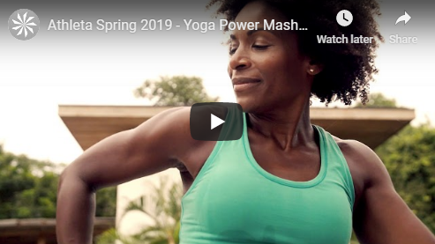
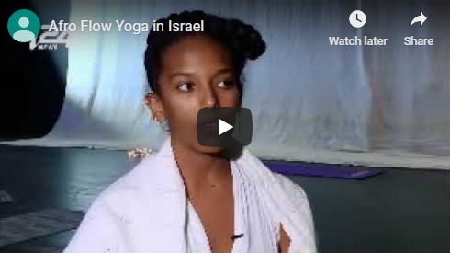
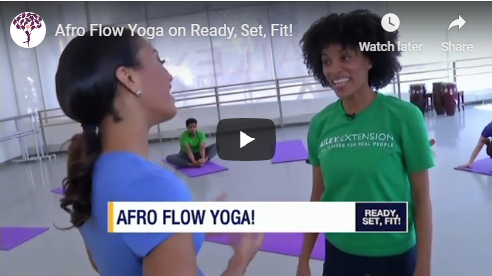
BROADCAST MEDIA
Click on image for video
Afro Flow Yoga featured in the OWN network’s film, Dark Girls 2: Deep, Dark and Divine (The Journey to Healing). Released on June 23, 2020.
Afro Flow Yoga featured in Athleta Spring 2019 ad campaign
Afro Flow Yoga instructor, Netsanet Mekonen (based in Israel), interview with i24news - 2018
Afro Flow Yoga on Ready, Set, Fit - 2018

Slide 12
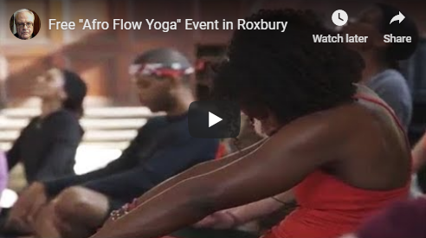
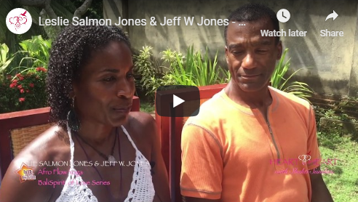
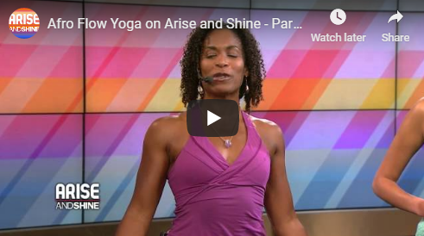
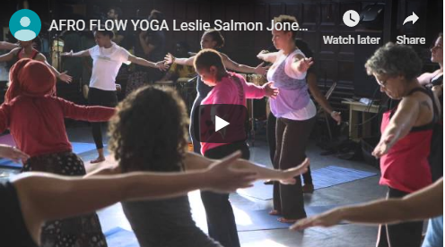
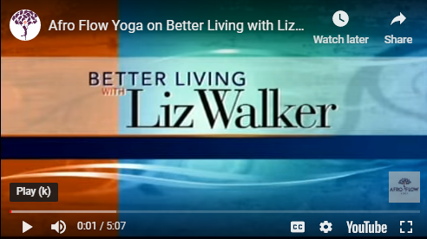
BROADCAST MEDIA
Click on image for video
Afro Flow Yoga interview with BNN News - 2017
Afro Flow Yoga interview with Shakti Sundari at Bali Spirit Festival - 2017
Afro Flow Yoga on Arise and Shine – 2014
Afro Flow Yoga at The Dance Complex - 2013
Afro Flow Yoga on Better Living with Liz Walker - 2011

Slide 13


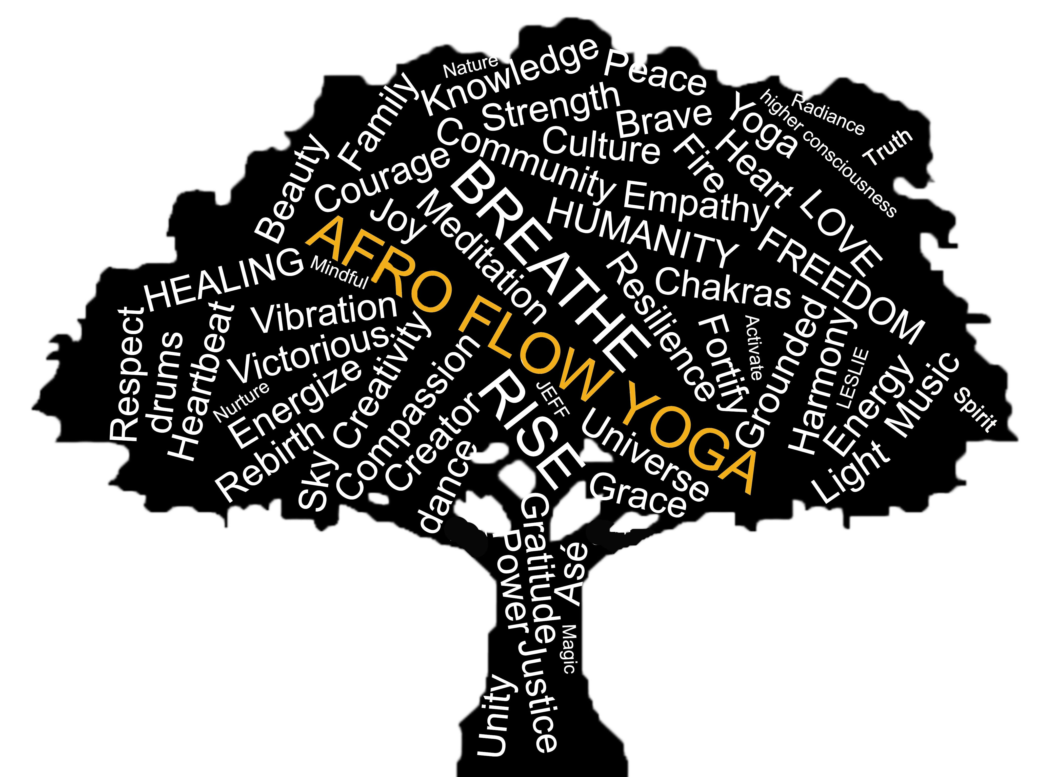

RESOURCES
www.afroflowyoga.com/resources
Afro Flow Yoga® Training programs: Module 1 – Foundations
Immerse in the history and the culture of the African Diaspora, in your inheritance and legacies. Explore the practice of self-discipline and spiritual development.
History of Racism
Books, articles, documentaries, resource lists, Dark Girls 2 documentary on the OWN network featuring segment on Afro Flow Yoga
Restoring our Roots to Rise
Organizations for Mental Health, organizations, community offerings, meditation resources, books, videos
Black-owned businesses resources
Deconstructing Racism and becoming Anti-Racist
Organizations, books, articles, resource list, podcasts, videos

Slide 14

USE OF SYMBOLS
Afro Flow Yoga® uses several symbols from West African wisdom – the Adinkra symbols.
ADINKRAHENE is chief of the Adinkra symbols. It is a symbol of greatness, charisma and leadership. This symbol is said to have played an inspiring role in the designing of other symbols. it signifies the importance of playing a leadership role.
SANKOFA teaches us that we must go back to our roots in order to move forward. That is, we should reach back and gather the best of what our past has to teach us, so that we can achieve our full potential as we move forward. Whatever we have lost, forgotten, forgone, or been stripped of can be reclaimed, revived, preserved, and perpetuated.
SESA WO SUBAN signifies personal reflection and life transformation. It‘s a composition of two symbols; the inner star which represents a new day and an outer wheel which implies initiative and moving forward. The symbol encourages people to make a positive change to the world by their actions.
MAKO is a symbol of inequality, uneven resources and uneven development. This proverb admonishes the greater ones to help the less fortunate with the implicit understanding that fortunes could reverse so that they would also need someone’s help. That is, “time changes” so any advantage one may have now may not persist forever.

